Slide 1




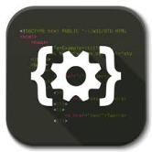


Timeline chart
LITERATURE SURVEY
913/09/17
PBM IDENTIFIED
HARDWARE ANALYSIS
CODING ARDUINO IDE
INTEGRATION WITH IDE
TESTING
DELIVERY

